Slide 1

Marketing Analytics Using AI & Machine Learning
Essis Desiree & Irene Lesitsi UID: 25MDA10001 & 25MDA10002 Date: 09.09.2025

Slide 2
Executive Summary
This project demonstrates the powerful application of AI and data science to transform a standard e-commerce transaction dataset into a strategic asset. Key objectives: customer segmentation using RFM and sales forecasting with Prophet algorithm. Recommendations: focus retention on Super VIPs & Loyal segments, target inactive customers, and integrate forecasts into planning.

Slide 3
Introduction
Objectives:
1. Perform EDA to understand transactional data.
2. Apply AI-driven clustering for customer segmentation.
3. Develop predictive sales forecasting model.
Dataset: Tata Online Retail (UK-based giftware retailer).

Slide 4
Exploratory Data Analysis (EDA)
Removed cancelled transactions and missing CustomerID.
Converted InvoiceDate to datetime.
Created TotalPrice = Quantity x UnitPrice.
Visual insights: Monthly sales trends, Top products by quantity & revenue, Top countries by sales.

Slide 5
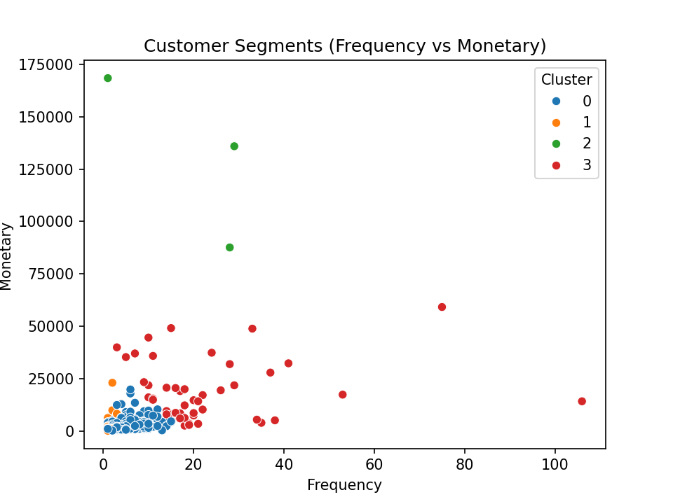
Customer Segmentation (K-Means)
RFM Model: Recency, Frequency, Monetary.
4 Clusters:
1. Standard customers
2. Inactive customers
3. Super VIPs
4. Loyal spenders
-Helps target marketing strategies.

Slide 6
Impact on Marketing Mix (7Ps)
-Product: Premium items for VIPs.
-Price: Discounts for inactive customers.
-Place: Direct channels for VIPs.
-Promotion: Targeted campaigns.
-People: Focus on high-value clients.
-Process: Automated CRM workflows.
-Physical Evidence: Enhanced packaging for premium customers.

Slide 7
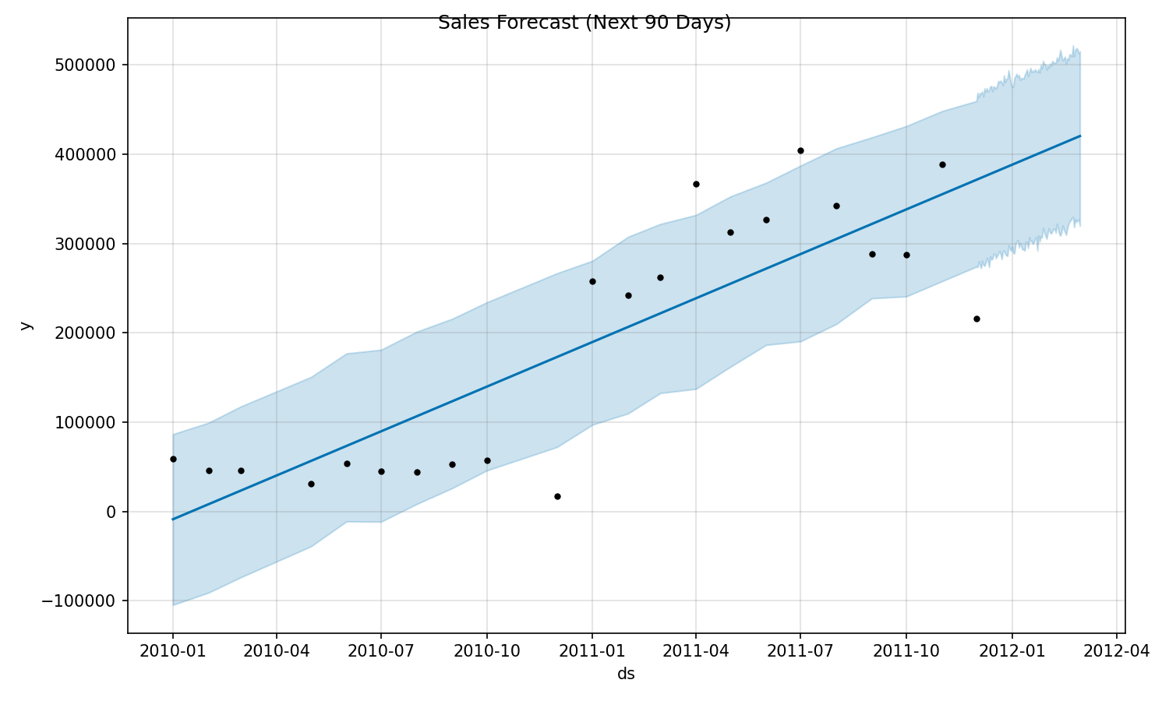
Sales Forecasting (AI - Prophet)
-Aggregated daily & monthly sales data.
-Forecast horizon: 90 days ahead.
-Stable but slight downward trend forecasted.
-Confidence intervals included for planning.

Slide 8
Conclusion & Recommendations
-Successful segmentation and forecasting.
-Immediate action: Loyalty programs, win-back campaigns.
-Medium-term: Refine product & promotion strategies.
-Long-term: Automate analytics, integrate into CRM, run A/B tests.
-Focus on continuous data-driven strategy.

